Slide 1
Lesson objective
Need rulers and calculators.
Title: Linear sequences
Aim – be able to:
Determine if a sequence is linear
Plot graphs from sequences
Plan:
Review rules
Plotting graphs

Slide 2
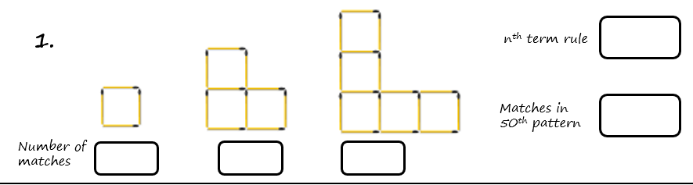
Term number | 1 | 2 | 3 | 4 | 50
Number of matches
Notes:
Have students draw the next shape in the pattern on their whiteboards.

Slide 3
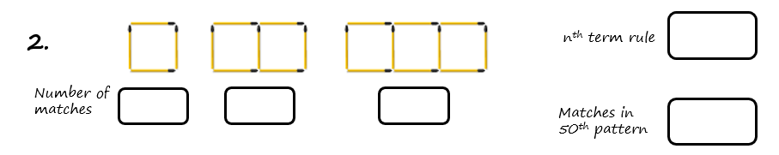
Term number | 1 | 2 | 3 | 4 | 50
Number of matches
Notes:
Have students draw the next shape in the pattern on their whiteboards.

Slide 4
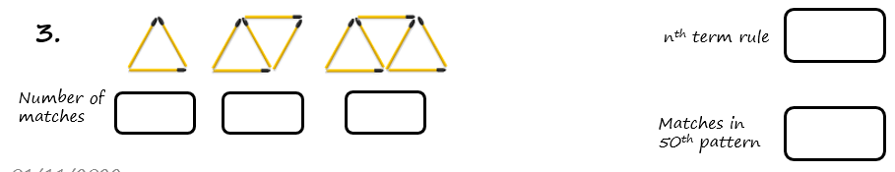
Term number | 1 | 2 | 3 | 4 | 50
Number of matches
Notes:
Have students draw the next shape in the pattern on their whiteboards.

Slide 5
What is linear?
An equation or sequence is linear if its graph forms a straight line.
An equation or sequence is _____ if its graph forms a straight line.
An equation or sequence is _____ if its graph forms a _______ line.
If an equation forms a straight line on a graph it is said to be……..

Slide 6
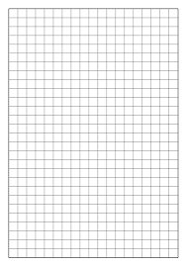

Plotting
Draw x and y axis and number
Use table of values as co-ordinates and plot each dot
If we draw a line connecting all these dots, is it linear?
Your expectations:
Listen and copy on to your sheet as we go along.
X | 0 | 1 | 2 | 3
Y | ? | 3 | 5 | 7

Slide 7
Plotting
Draw x and y axis and number
Use table of values as co-ordinates and plot each dot
If we draw a line connecting all these dots, is it linear?
Your expectations:
Listen and copy on to your whiteboards as we go along.
X | 0 | 1 | 2 | 3
Y | 2 | 6 | 10 | 14

Slide 8
Plotting
Draw x and y axis and number
Use table of values as co-ordinates and plot each dot
If we draw a line connecting all these dots, is it linear?
Your expectations:
Listen and copy on to your whiteboards as we go along.
X | 0 | 1 | 2 | 3
Y | 2 | 4 | 7 | 11

Slide 9
Plotting
Draw x and y axis and number
Use table of values as co-ordinates and plot each dot
If we draw a line connecting all these dots, is it linear?
Your expectations:
Listen and copy on to your whiteboards as we go along.
X | 0 | 1 | 2 | 3
Y | -4 | -2 | 0 | 2

Slide 10
Practice
You will need 1 piece of grid paper.
Page 130
Questions 1 - 10

